Slide 1
1
Automatic HamNoSys Generation from Sign Language Videos using Handshape, Orientation, Location, and Movement Learning with Avatar-Based Verification
Group_No: 14
Guide: Ms.Nalinadevi K, Assistant Professor (Sl.Gd.)
SL NO. | Name | Roll No
1 | Soma Siva Pravallika | CB.EN.U4CSE22440
2 | Sribhashyam Indira Satya Sri | CB.EN.U4CSE22441
3 | Oruganti Sravani | CB.EN.U4CSE22457
4 | Dasari Vamsi Krishna | CB.EN.U4CSE22458

Slide 2
Introduction
Sign language is a visual communication system.
Different regions have different sign languages.
No standardized writing system for sign language.
HamNoSys represents signs using symbolic notation.
Manual transcription is slow, so automation is needed.
Automated systems can generate HamNoSys from sign videos.

Slide 3
Problem Statement
To develop an automatic system that generates HamNoSys from sign language videos by modeling handshape combinations, orientation, location, and movement, and verifies its accuracy through avatar-based verification.

Slide 4
Motivation
There is no widely used writing system to represent sign language digitally for deaf and hard-of-hearing people.
HamNoSys provides a symbolic notation, but manual transcription is slow and requires expert knowledge.
Public datasets with HamNoSys annotations are very limited, making automatic generation challenging.
An automatic system that converts sign images/videos into HamNoSys can help in research, education, and sign language technology.
Avatar-based verification can help ensure that generated HamNoSys correctly represents the original sign.

Slide 5
Dataset description
A custom dataset was created because no public dataset exists for HamNoSys handshape combinations.
The dataset contains 149 different HamNoSys handshape combinations.
For each combination, custom hand images were captured and labeled.
Images were organized into folders based on the handshape combination (e.g., hamfist + hamthumbopenmod).
A structured CSV mapping file stores:
Combination → Handshape combination name
Command → Corresponding HamNoSys symbolic code
Hex Codes → Unicode/Hex values for rendering

Slide 6
Data augmentation (rotation, scaling, flipping) was applied to increase dataset size and improve model robustness.
MediaPipe Hands was used to extract 21 hand landmarks (x, y, z) from each image
The extracted landmarks form feature vectors used for model training.
Each sample is labeled using the HamNoSys combination defined in the CSV mapping file.

Slide 7
Literature Survey
Year | Authors | Key Contribution | Limitation
2016 | Kaur & Kumar | HamNoSys → SiGML conversion for ISL animation | Only isolated signs, manual annotation required
2020 | Saunders et al. | SignGAN: speech → photorealistic sign video | High computational cost, needs large annotated datasets
2020 | Goyal et al. | Grammar-based English → ISL animation | Rule-dependent, not scalable, ambiguity issues
2020 | Skobov & Lepage | Video → HamNoSys automatic annotation | Accuracy affected by video quality, finger/facial capture limited
2022 | Shalev-Arkushin et al. | HamNoSys → 3D pose sequences | Needs HamNoSys expertise, coarticulation handling difficult
2023 | Forte et al. | Linguistic priors + deep learning for video → avatar | Requires extensive linguistic modeling, high-quality videos
2023 | Yu et al. | SignAvatars dataset: large-scale 3D motion | Limited language coverage, facial expressions challenging
2023 | Gil-Martín et al. | Motion generation from linguistic features | Needs accurate annotations, hard to scale to continuous signing
2023 | Villa-Monedero et al. | Dataset for motion generation | Limited size & coverage
2024 | Krishnamurthy et al. | DiffSign: diffusion model for customizable sign videos | Computationally heavy, dataset scarcity

Slide 8
Research Gap
Existing works focus mainly on isolated signs, while continuous sign streams remain underexplored.
Prior systems depend heavily on manual annotation or handcrafted grammar rules, making them slow and error-prone.
Most systems lack a verification mechanism to check correctness of generated HamNoSys against the original signing.
Location modeling is often coarse or absent, with insufficient differentiation between head, face, torso, neutral space, and fine-grained contact regions.
Most systems do not accurately capture movement types (straight, curved, circular, inward/outward, diagonal), which are critical components of HamNoSys representation.
There is no integrated framework that jointly models handshape, orientation, location, and movement (H–O–L–M) from video in a grammatically valid HamNoSys pipeline.
Public sign language datasets lack HamNoSys-level movement and location annotations, limiting supervised learning and scalable evaluation.

Slide 9
Objective
Automatically find where the sign is made (head, face, chest, neutral space, hand-to-hand or hand-to-body) from sign language videos using body and hand landmarks.
Use rule-based logic to convert landmark distances and body zones into correct HamNoSys location symbols.
Detect how the hand moves (straight, curved, circular, diagonal, in or out) by tracking hand positions across video frames.
Split continuous videos into movements and signs, so each sign’s movement and location are identified correctly.

Slide 10
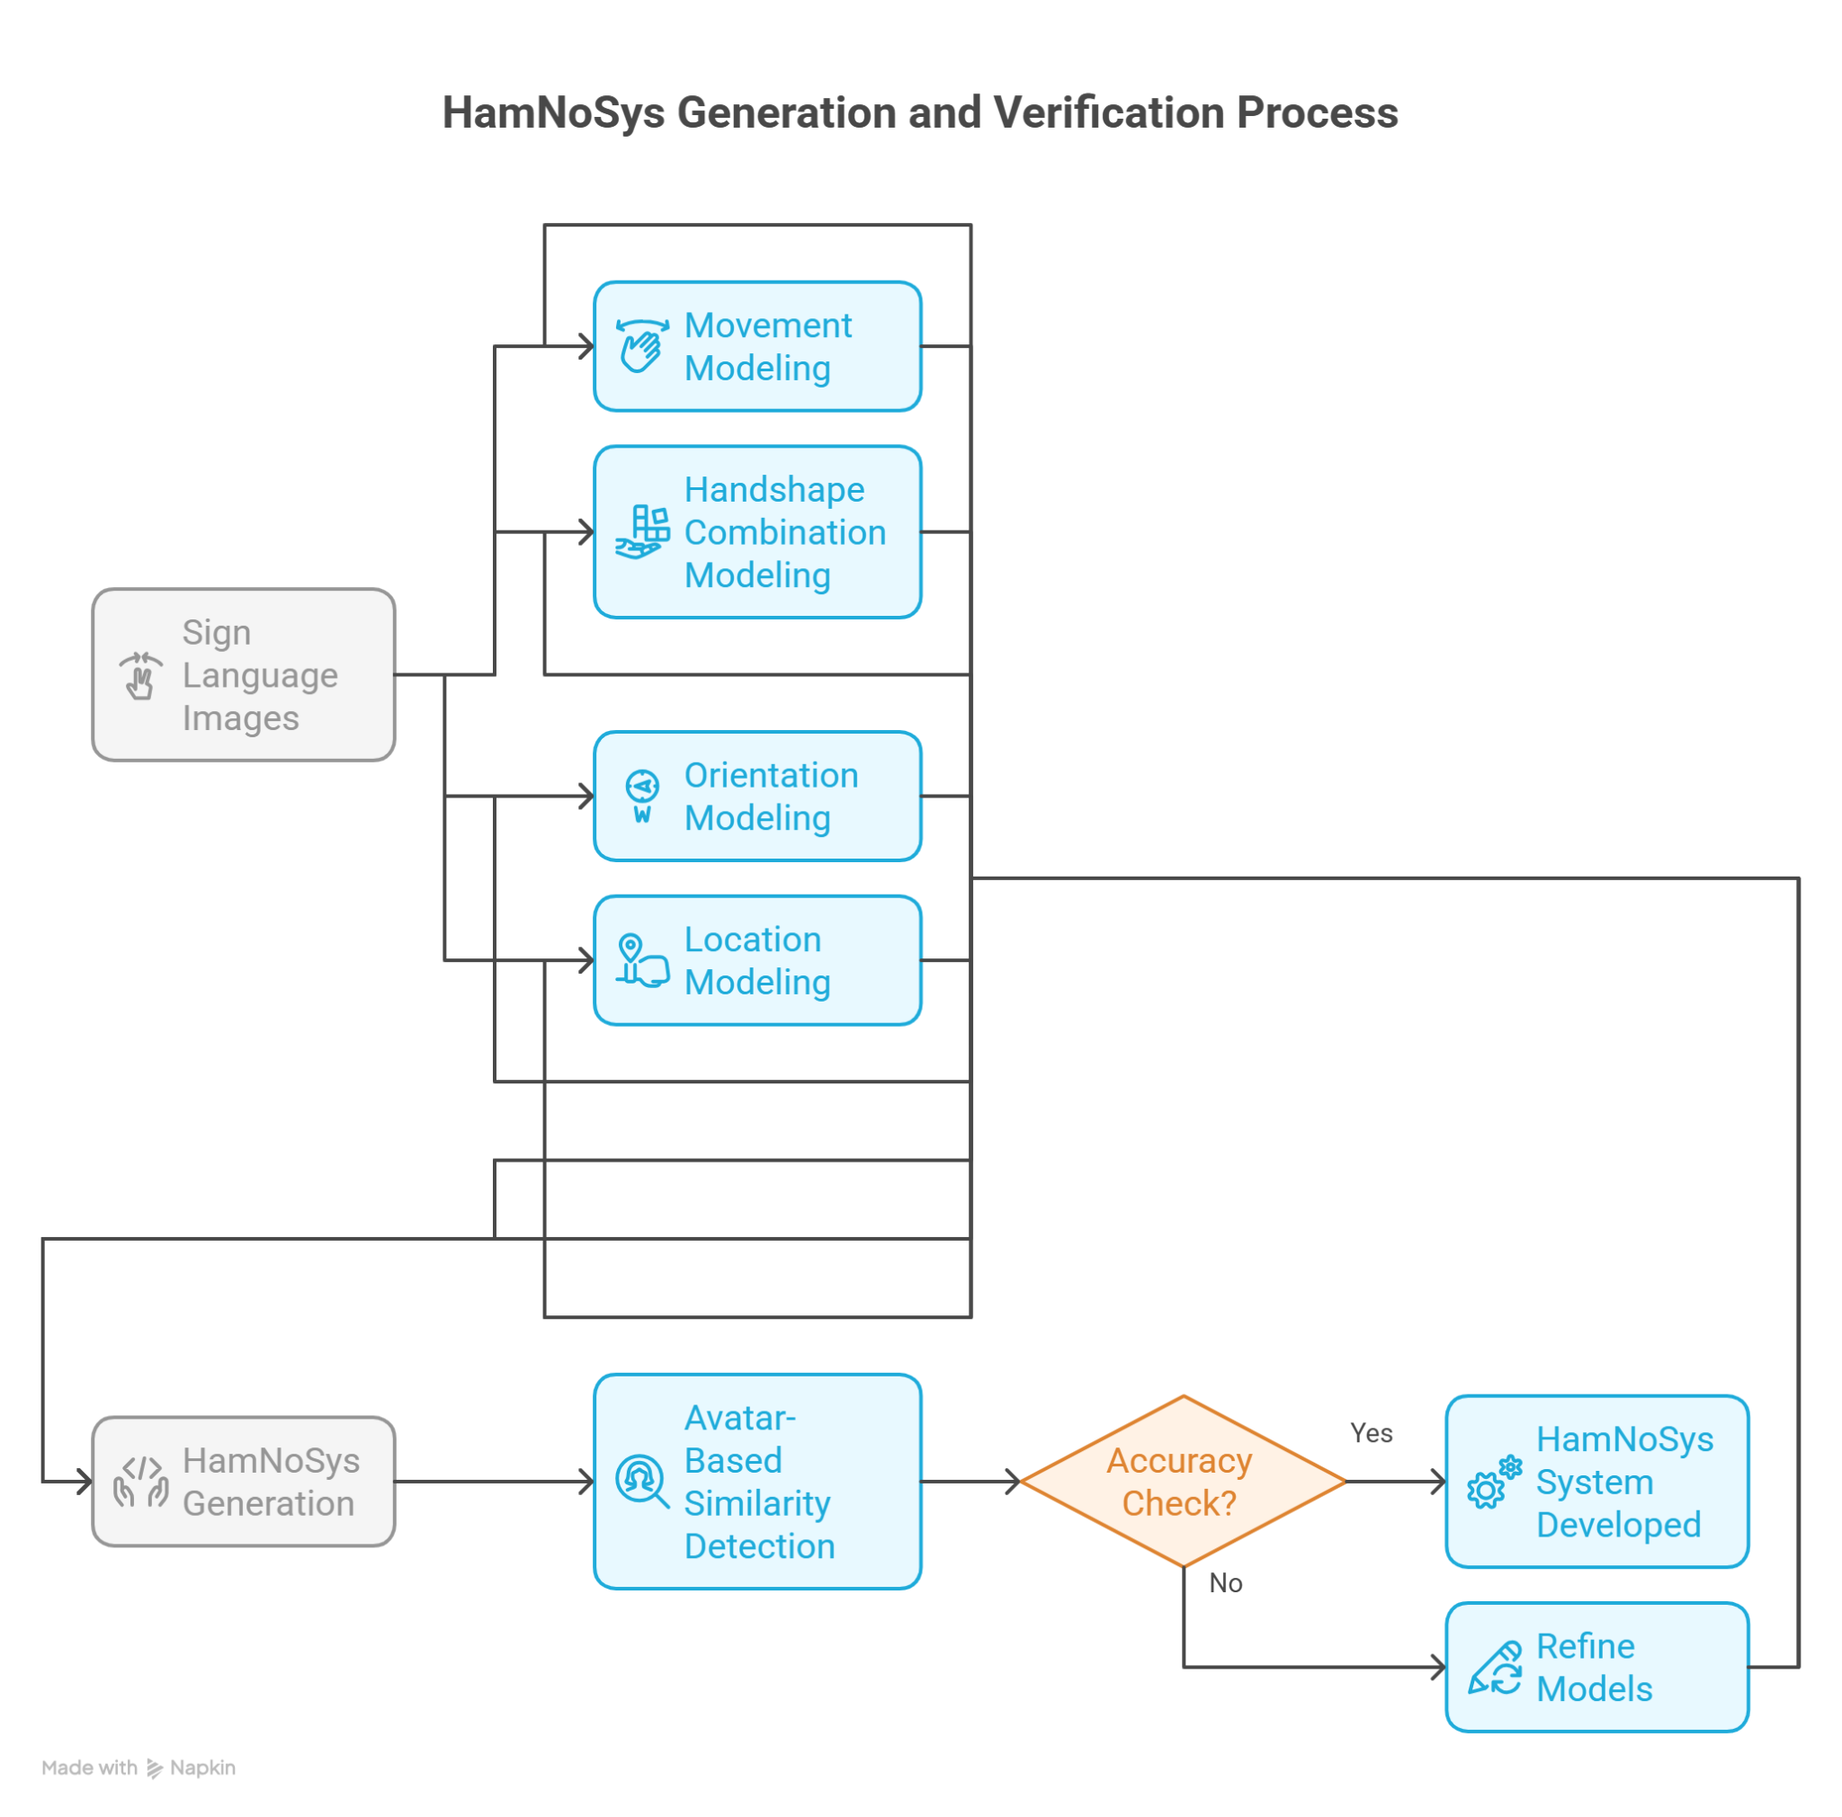
Proposed Work Plan

Slide 11
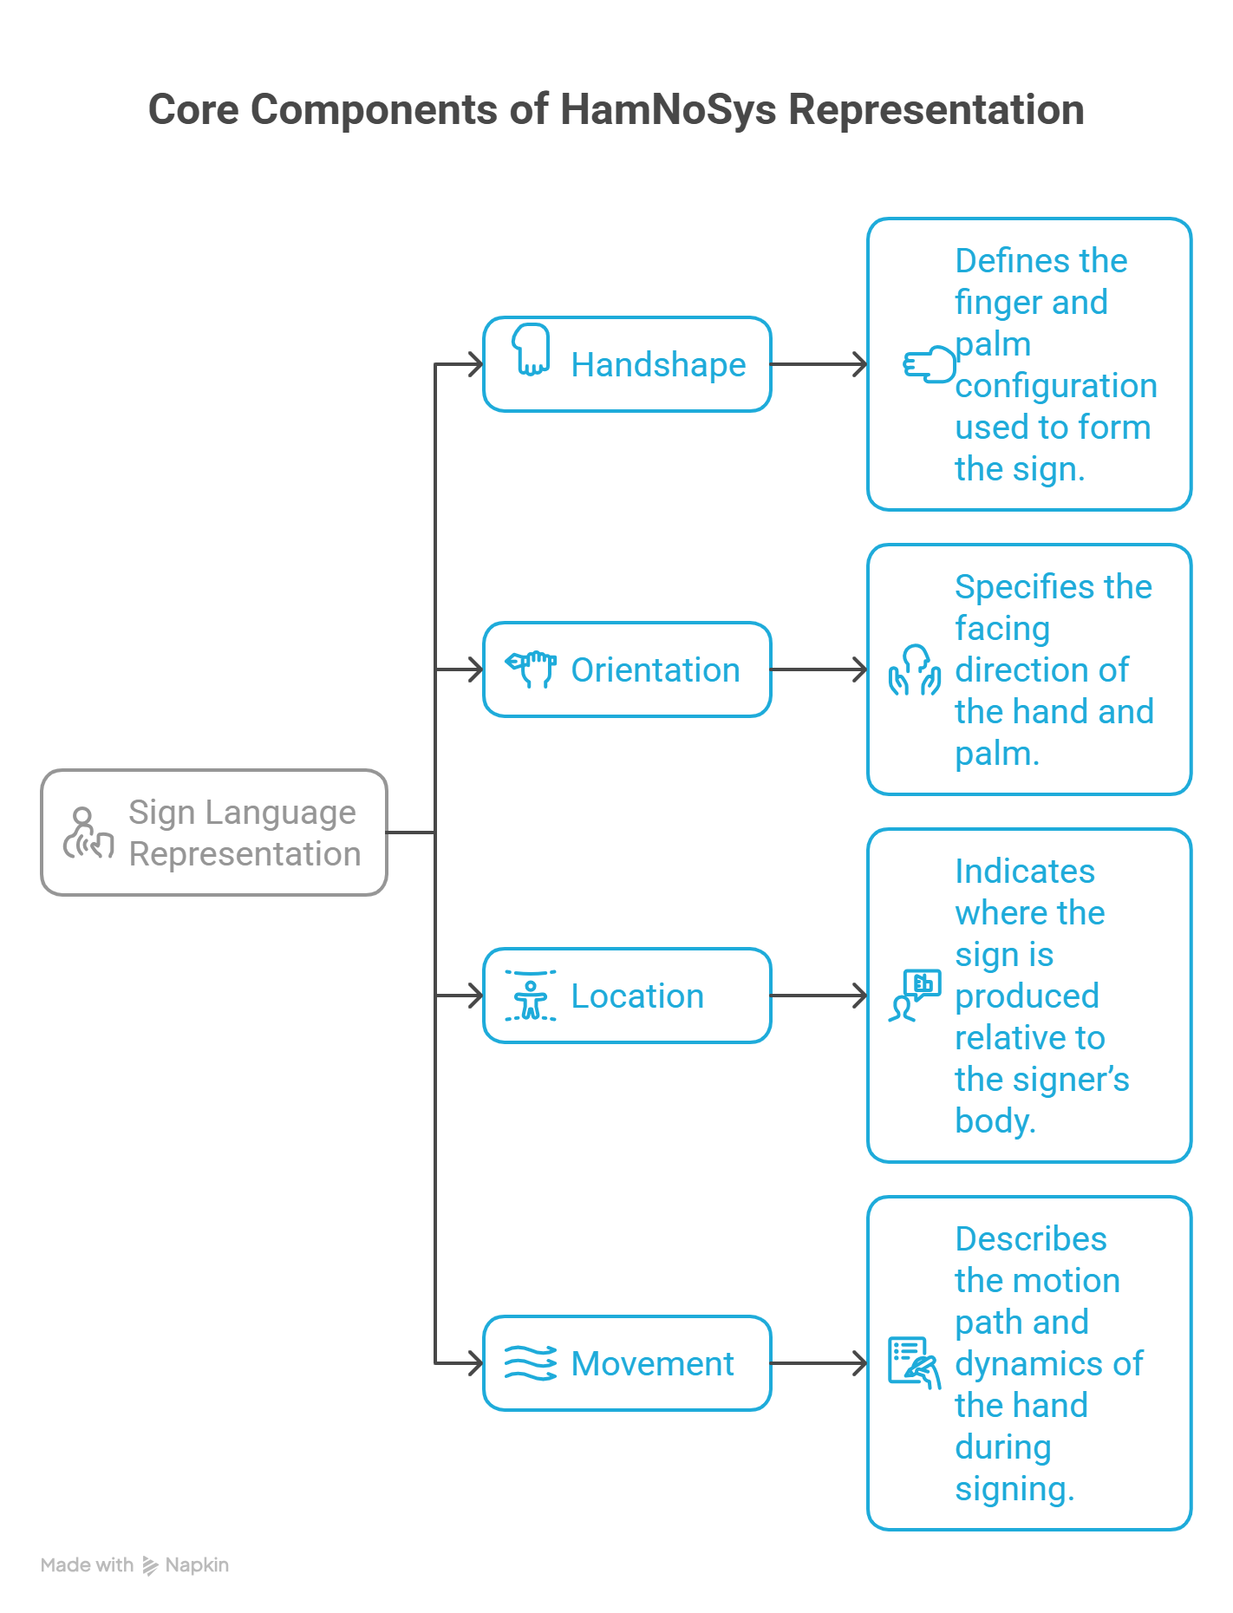

Slide 12
HandShape Module-Local Per Node Representation
Handshape is represented using a Local Per Node structure based on HamNoSys grammar.
The handshape is decomposed into independent nodes to simplify recognition and improve scalability.
Nodes used in the model:
A – Basic Handshape: Main hand configuration.
C – Thumb Modifier: Describes thumb position or modification.
D – Finger Type: Indicates finger bending or extension type.
E – Finger Contact: Specifies which fingers are involved in the sign.
X – Extra (Optional): Additional modifiers if present.
A Directed Acyclic Graph (DAG) structure is used to represent valid handshape paths.
The final HamNoSys handshape is generated by combining node outputs according to the DAG grammar.

Slide 13
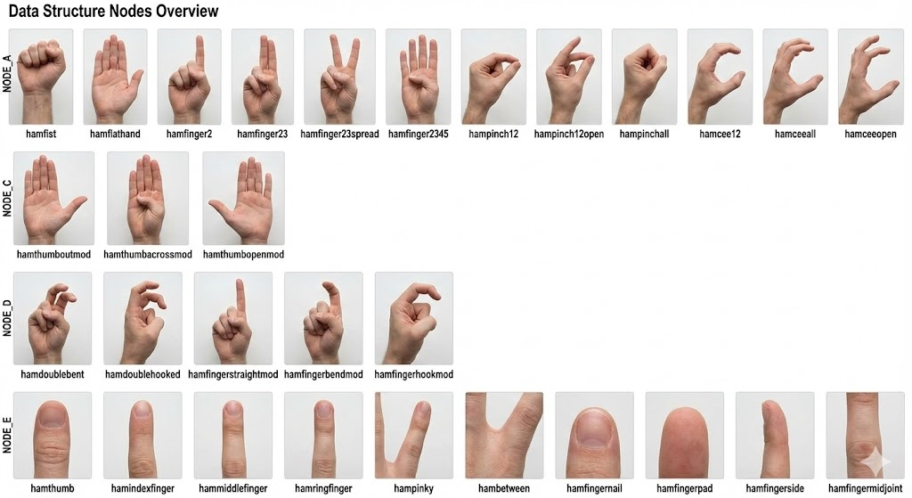

Slide 14
Orientation
View Detection:
Classifies the camera viewpoint using wrist–eye–shoulder geometry:
Signer View (front)
Right View
Bird View (top)
Finger Orientation:
Uses wrist → index-tip vector + depth/tilt.
Mapped to HamNoSys directional classes (e.g., hamextfingeru, hamextfingerdl, etc).
Palm Orientation (Implemented):
Normal vector from index MCP × pinky MCP.
Mapped to 8 HamNoSys palm directions (e.g., hampalmu, hampalmul, etc).

Slide 15
Location Module
HamNoSys Location describes where a sign is produced relative to the signer’s body.
For systematic recognition, locations are divided into the following groups:
Head & Face Locations (forehead, nose, lips, chin, eyes, ears, etc.)
Upper Body Locations (shoulders, chest, stomach, arms, wrist)
Hand Locations (palm, thumb base, hand back, thumb side, pinky side)
Finger Locations (fingertips, finger joints, between fingers)
Contact Types (touch, close, brush, interlock, cross)
Arm & Space Positions (neutral space, arm extended, beside body)

Slide 16
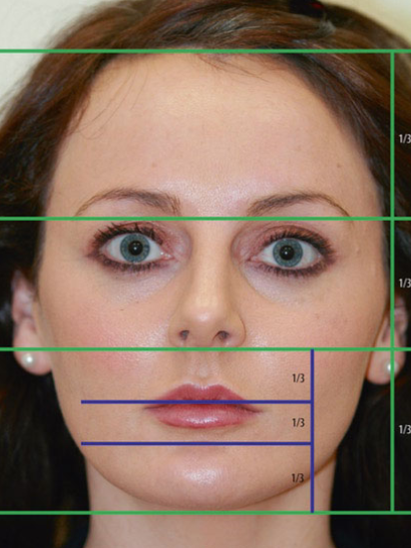
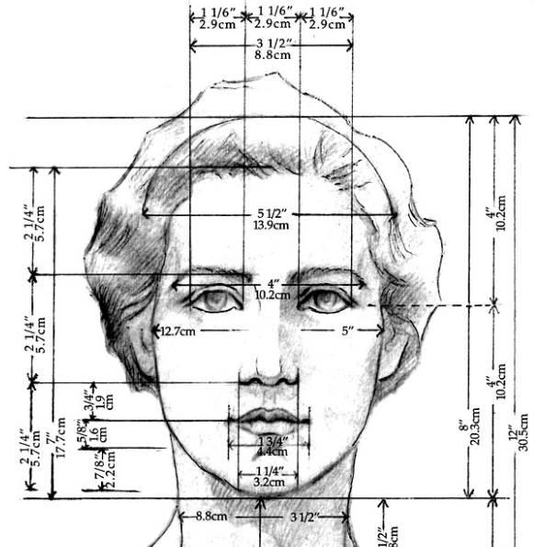
Head & Face Location
Goal: Identify which part of the head or face is being touched during signing.
Step 1:
MediaPipe detects the face bounding box (hairline → chin).
face_h = y2 - y1 , Face height = Hairline → Chin
All fingertip positions are normalized as:
Relative vertical position (rel_y) = (finger_y − face_top) / face_height
This makes detection independent of face size, camera distance, and person variation.
Horizontal Face Division : The face (hairline → chin) is divided into three equal horizontal parts:
Upper Third: Hairline → Eyebrows (0.00 – 0.33) (hairline, headtop, forehead)
Middle Third: Eyebrows → Nose Base (0.33 – 0.66) (eyes, nose, nostrils)
Lower Third: Nose Base → Chin (0.66 – 1.00) (lips, teeth, chin)

Slide 17
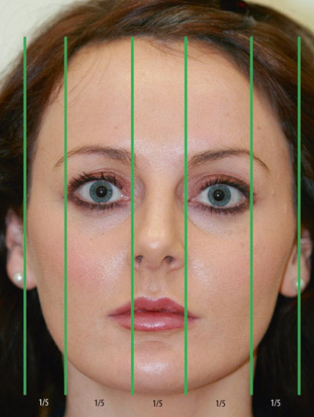

Lower Third (0.66–1.00) represents the mouth–chin region and is divided into three equal parts.
Lips: 0.66–0.77, Teeth: 0.77–0.88, Chin: 0.88–1.00 (each ≈ 1/9 of face height).
This subdivision helps accurately detect mouth-related contact locations during signing.
Vertical Face Division (Five-Eye Rule): Face width is divided into five equal units.
Left Ear (0.00–0.20), Left Cheek (0.20–0.40), Nose Center (0.40–0.60), Right Cheek (0.60–0.80), Right Ear (0.80–1.00).

Slide 18
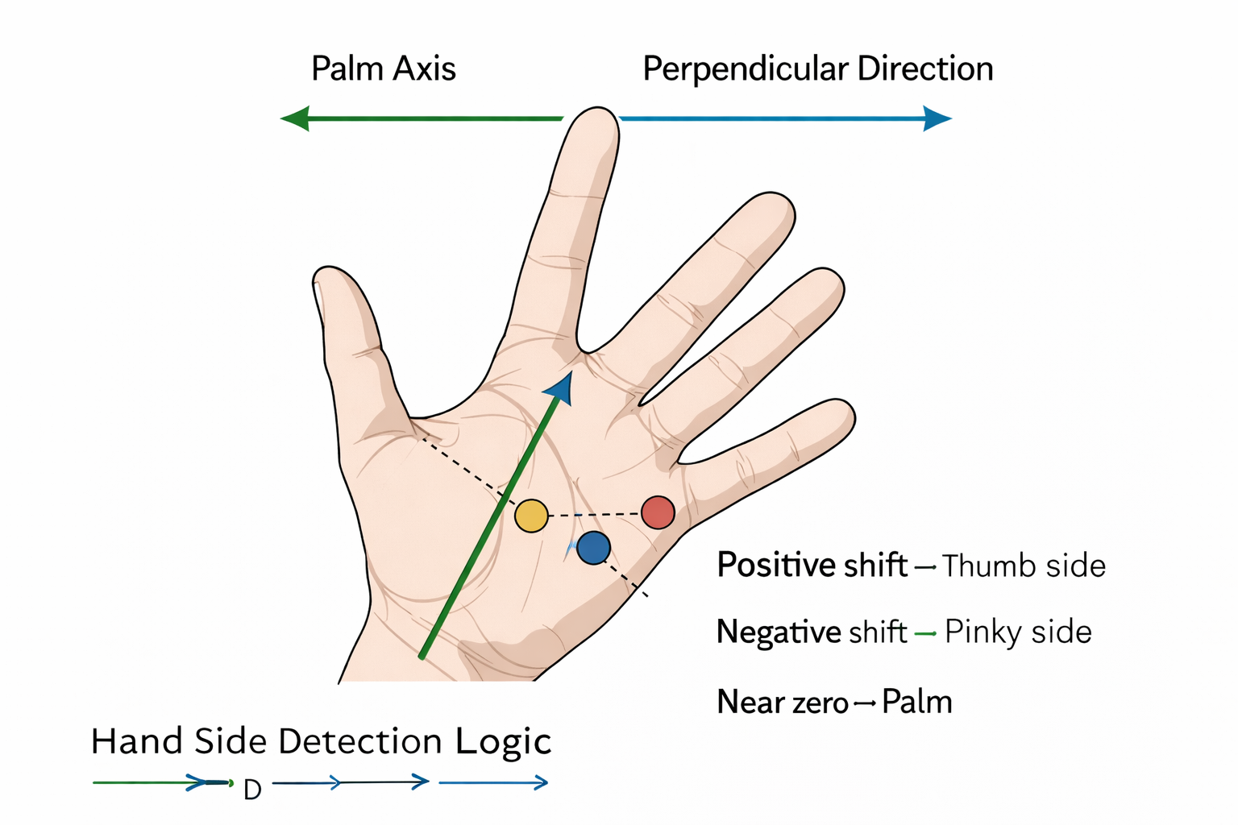
HAND LOCATIONS
Goal: Identify where the finger touches on the hand during signing.
Hand Regions: Thumb Ball, Palm, Back of Hand, Thumb Side, Pinky Side.
Thumb Ball Detection
Palm length ≈ 9 cm, thumb ball ≈ 3 cm → ratio ≈ 1/3
Detection threshold: distance ≤ 0.35 × palm_length
Palm Region
Palm radius ≈ 0.55 × palm_length
Contact near palm center → Palm location
Side Detection (Thumb vs Pinky)
Palm axis: wrist → middle finger base
Perpendicular axis gives left–right shift
Positive shift → Thumb side
Negative shift → Pinky side
Near zero → Palm
Left Hand Correction Left hand is mirrored → direction flipped Ensures: + = thumb side, − = pinky side for both hands.

Slide 19
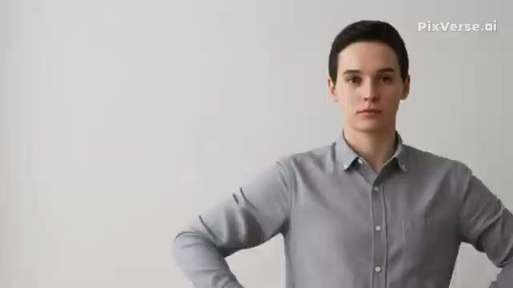
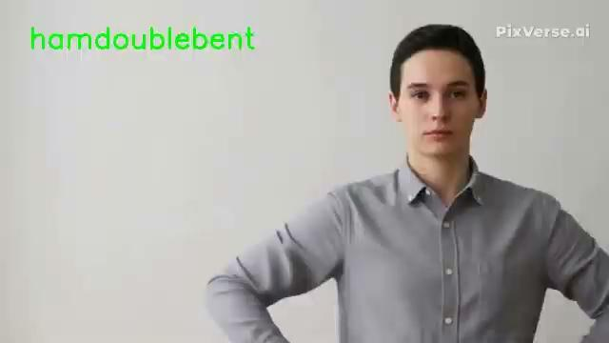
Input and Output

Slide 20

Movement 1
The Movement Module detects how the hand moves during signing.
It tracks the hand position in every video frame and calculates the change in position between consecutive frames.
Each frame provides a 3D hand coordinate:
The movement between frames is calculated as:
Using this frame-to-frame displacement, the system extracts the following movement properties:
Direction – left, right, up, down (hammovel, hammover, hammoveu, hammoved)
Depth – toward or away from the body (hammovei, hammoveo)
Speed – fast or slow movement (hamfast, hamslow)
Repetition – repeated movement patterns (hamrepeat)
Size – small or large motion (hamsmallmod, hamlargemod)
Path Shape – straight, curved, or zigzag (hamarc, hamzigzag)

Slide 21
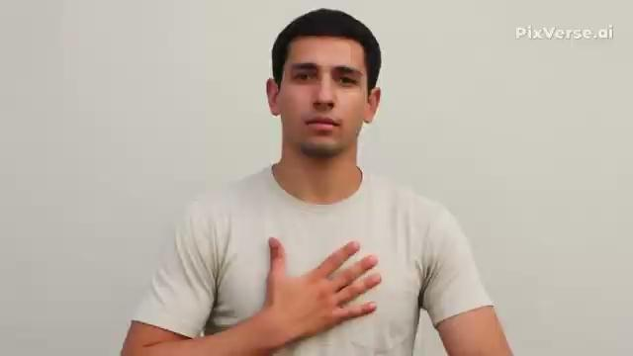
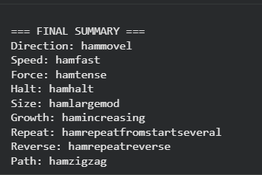

Slide 22
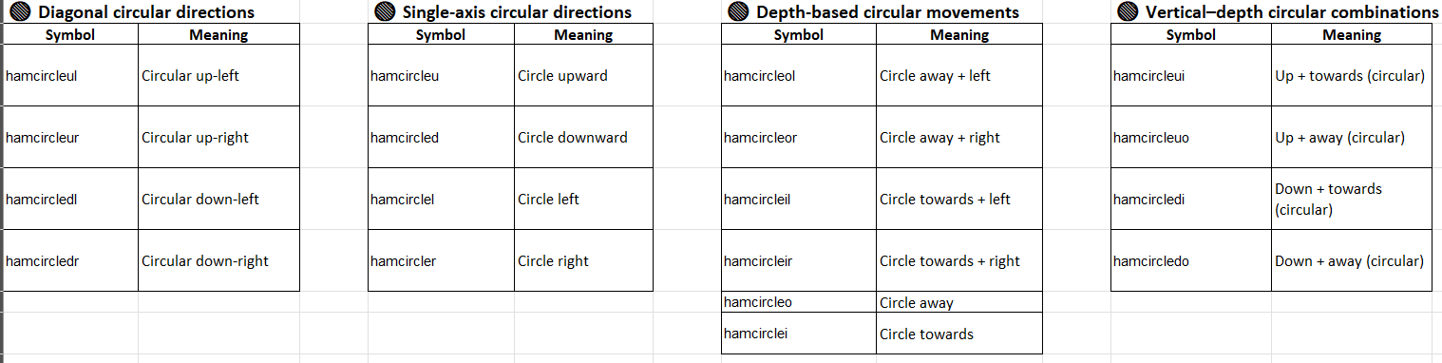
Movement - 2

Slide 23
Integration
All feature extraction modules are imported into the main pipeline script.
Each module processes the input video frame-by-frame.
The modules used in the system include:
Handshape, Orientation, Arm & Space, Upper Body, Head & Face, Hand Location, Finger Location, Contact Type, Movement
For every frame in the video:
Each module detects its respective features.
The detected HamNoSys labels are generated per frame.
The outputs from all modules are stored as per-frame HamNoSys tokens.
After processing the complete video:
The system analyzes all frame-level outputs.
The most frequently occurring HamNoSys labels (maximum occurrence) are selected.
These selected labels are combined to form the final HamNoSys representation of the sign.
The final result is the complete HamNoSys sequence describing the sign gesture.

Slide 24
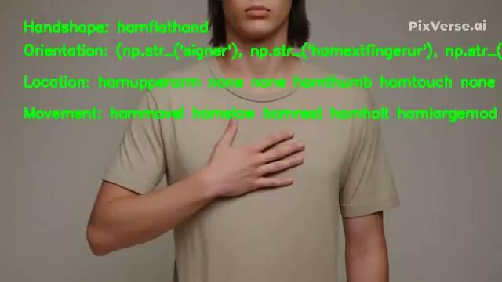
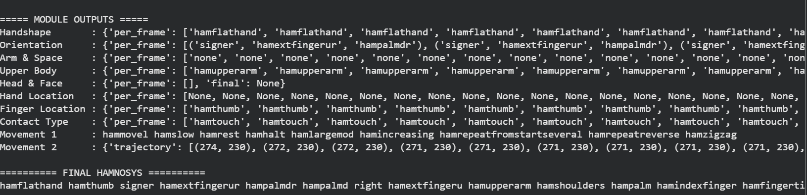
Integration

Slide 25
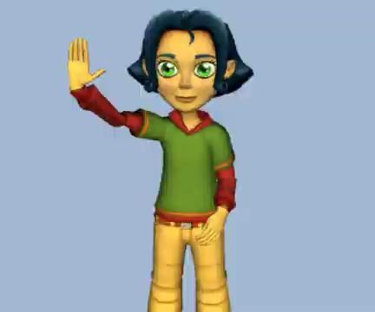
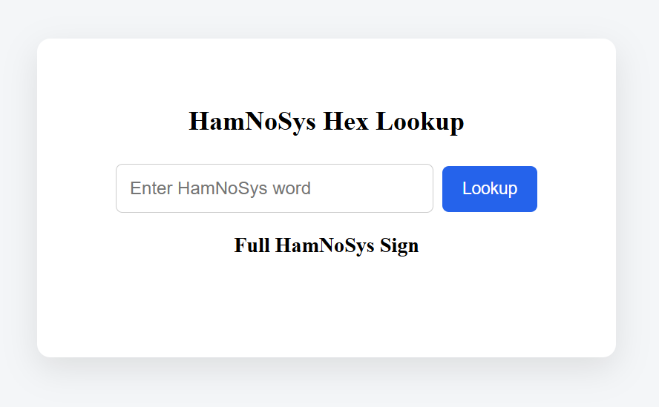
Avatar Verification
Step 1:
Input SiGMLcode is taken link: https://vhg.cmp.uea.ac.uk/demo/LinguaSign/SignFiles/Hello1n.LSN.sigml
Step 2:
Screen recorded the video for valid input:
Step 3: Give it as input for integration pipeline and get HamNoSys labels.
Step 4:
Then give the generated labels to the UI

Slide 26
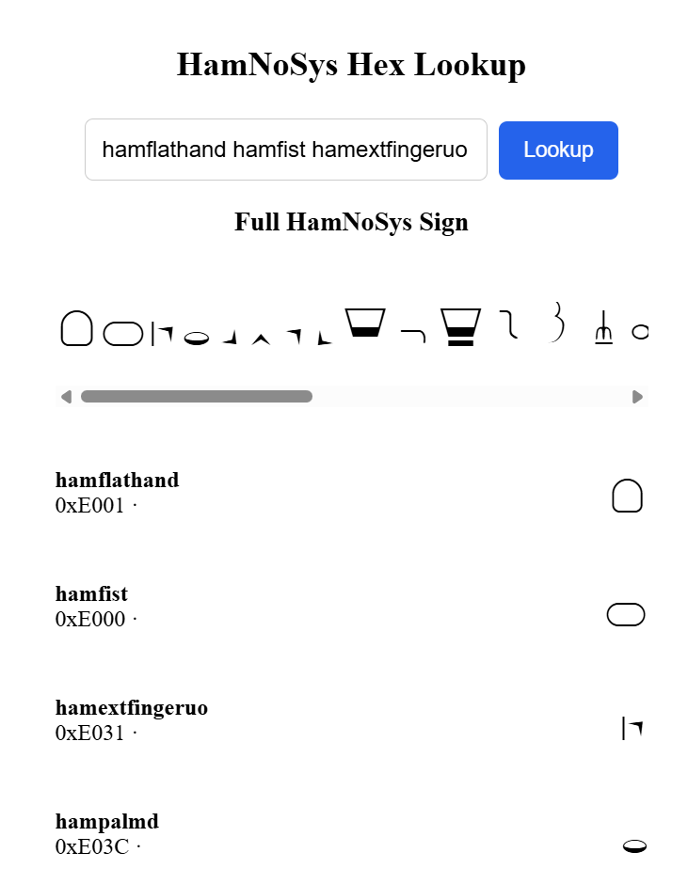
Avatar Verification
Step 5:
Then the output will be the HamNoSys symbols which will be generated.
Step 6:
Copying it and running python file, SiGML code will be generated.
Step 7: Comparison between the input SiGML and generated SiGML.
Step 8:
The accuracy comparison will give the verification of integration
pipeline.

Slide 27
References
[1] T. Hanke, “HamNoSys—Representing sign language data in language resources and processing contexts,” in Proc. LREC Workshop on Representation and Processing of Sign Languages, 2004, pp. 1–6. https://aclanthology.org/W04-1601.pdf
[2] K. Kaur and P. Kumar, “HamNoSys to SiGML conversion system for sign language automation,” 2016. https://www.researchgate.net/publication/306362600_HamNoSys_to_SiGML_Conversion_System_for_Sign_Language_Automation
[3] B. Saunders, N. C. Camgoz, and R. Bowden, “Everybody sign now: Translating spoken language to photo-realistic sign language video,” in Proc. IEEE/CVF Conf. Computer Vision and Pattern Recognition (CVPR), 2020. =https://arxiv.org/abs/2011.09846
[4] V. Skobov and Y. Lepage, “Video-to-HamNoSys automated annotation system,” in Proc. Sign Language Resources Workshop, 2020. https://aclanthology.org/2020.signlang-1.34.pdf
[5] R. S. Shalev-Arkushin, A. Moryossef, and O. Fried, “Ham2Pose: Animating sign language notation into pose sequences,” 2022. https://arxiv.org/abs/2211.13613
[6] M. Aziz and A. Othman, “Evolution and trends in sign language avatar systems: Unveiling a 40-year journey via systematic review,” Journal of Computer Languages, 2023. https://www.mdpi.com/2414-4088/7/10/97
[7] M.-P. Forte, M. Villa-Monedero, A. Pomirski, D. Sáez-Trigueros, and R. San-Segundo, “Reconstructing signing avatars from video using linguistic priors,” IEEE Transactions on Visualization and Computer Graphics, 2023. https://ieeexplore.ieee.org/document/10294272
[8] M. Gil-Martín, M. Villa-Monedero, A. Pomirski, D. Sáez-Trigueros, and R. San-Segundo, “Sign language motion generation from sign characteristics,” Computers & Graphics, vol. 113, pp. 16–27, 2023.
https://www.sciencedirect.com/science/article/pii/S0097849323000557https://www.mdpi.com/1424-8220/23/23/9365?
[9] D. Goyal and V. Goyal, “Development of Indian sign language dictionary using synthetic animations,” International Journal of Advanced Computer Science and Applications, vol. 7, no. 5, pp. 125–131, 2016.
https://thesai.org/Publications/ViewPaper?Volume=7&Issue=5&Code=IJACSA&SerialNo=18
[10] R. Joshi, S. Agrawal, and A. Modi, “ISLTranslate: Dataset for translating Indian sign language,” in Proc. 61st Annual Meeting of the Association for Computational Linguistics (ACL), 2023.
https://aclanthology.org/2023.acl-long.257.pdf

Slide 28

Questions
Any
Questions?

Slide 29
Thank You!!!

